Slide 1
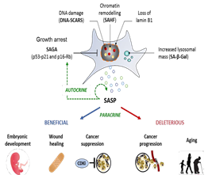
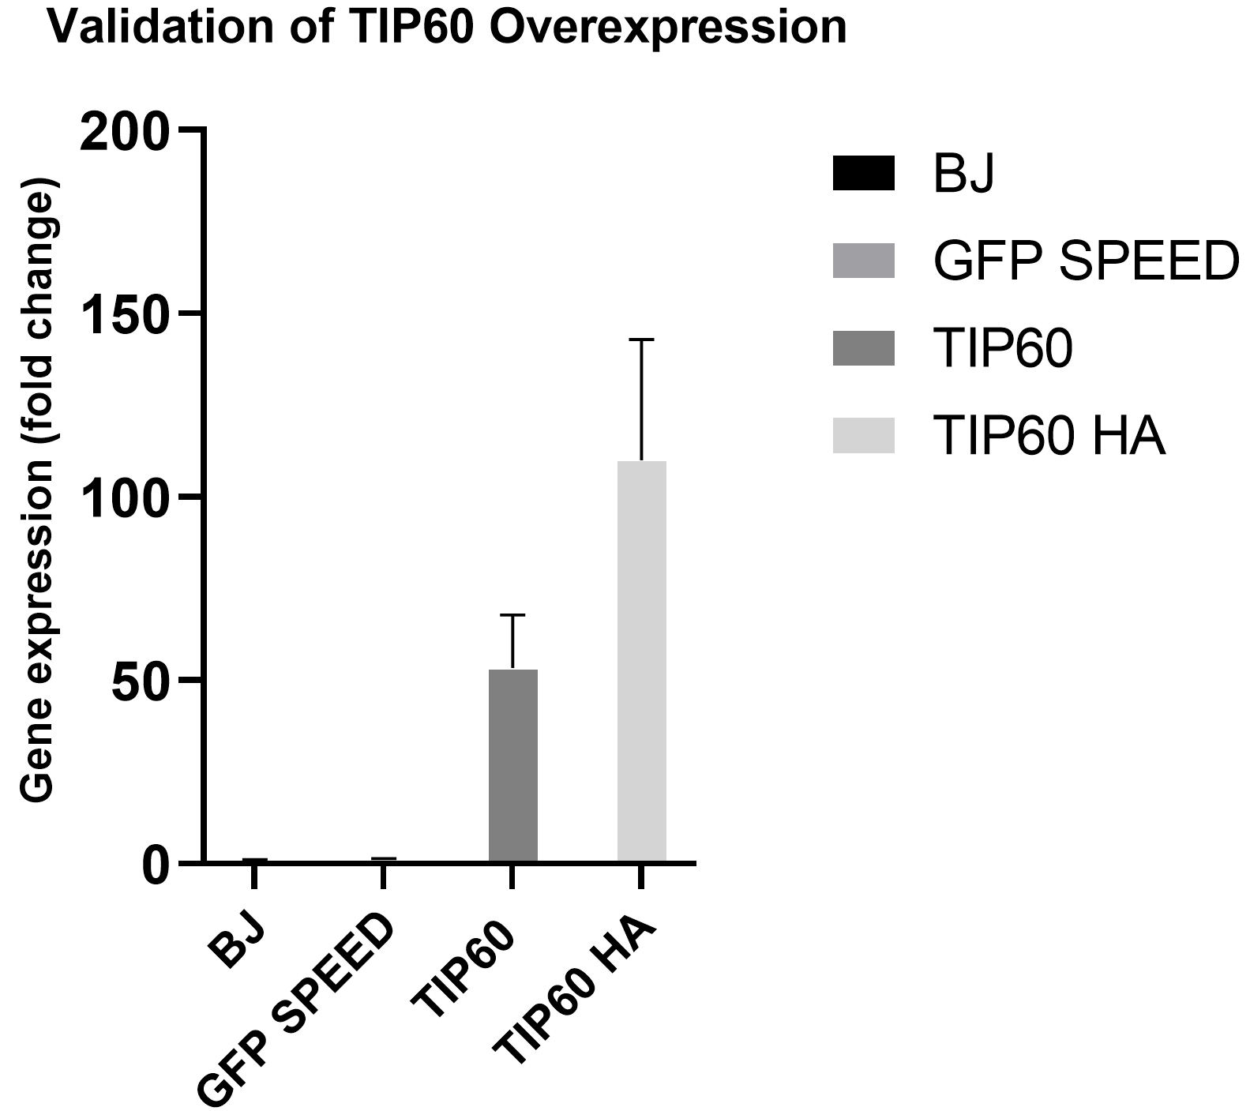
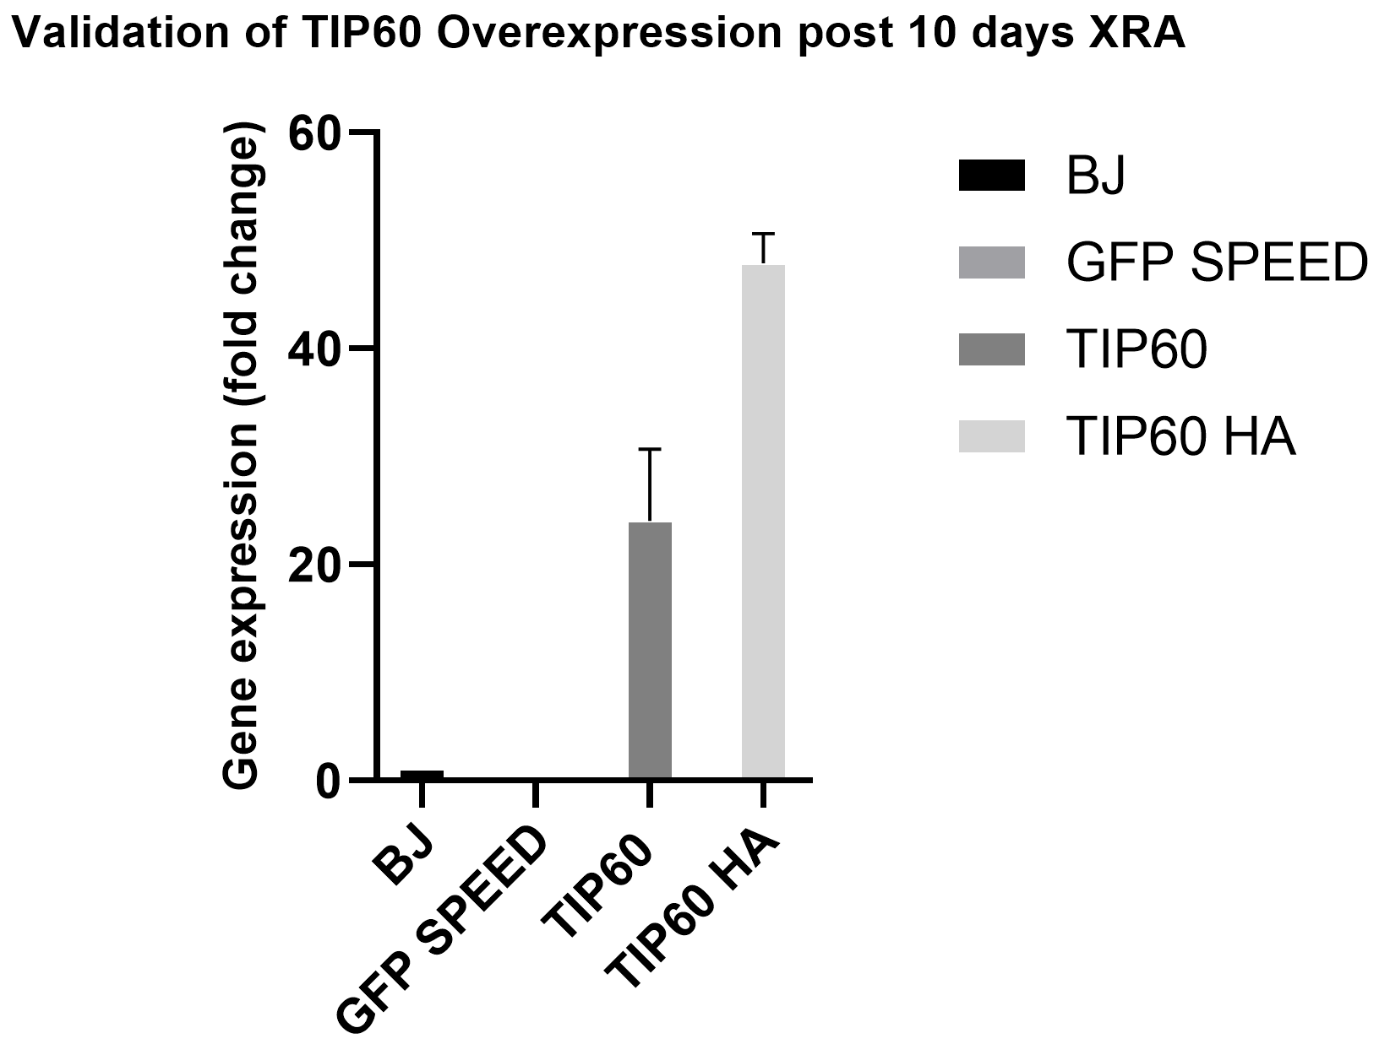
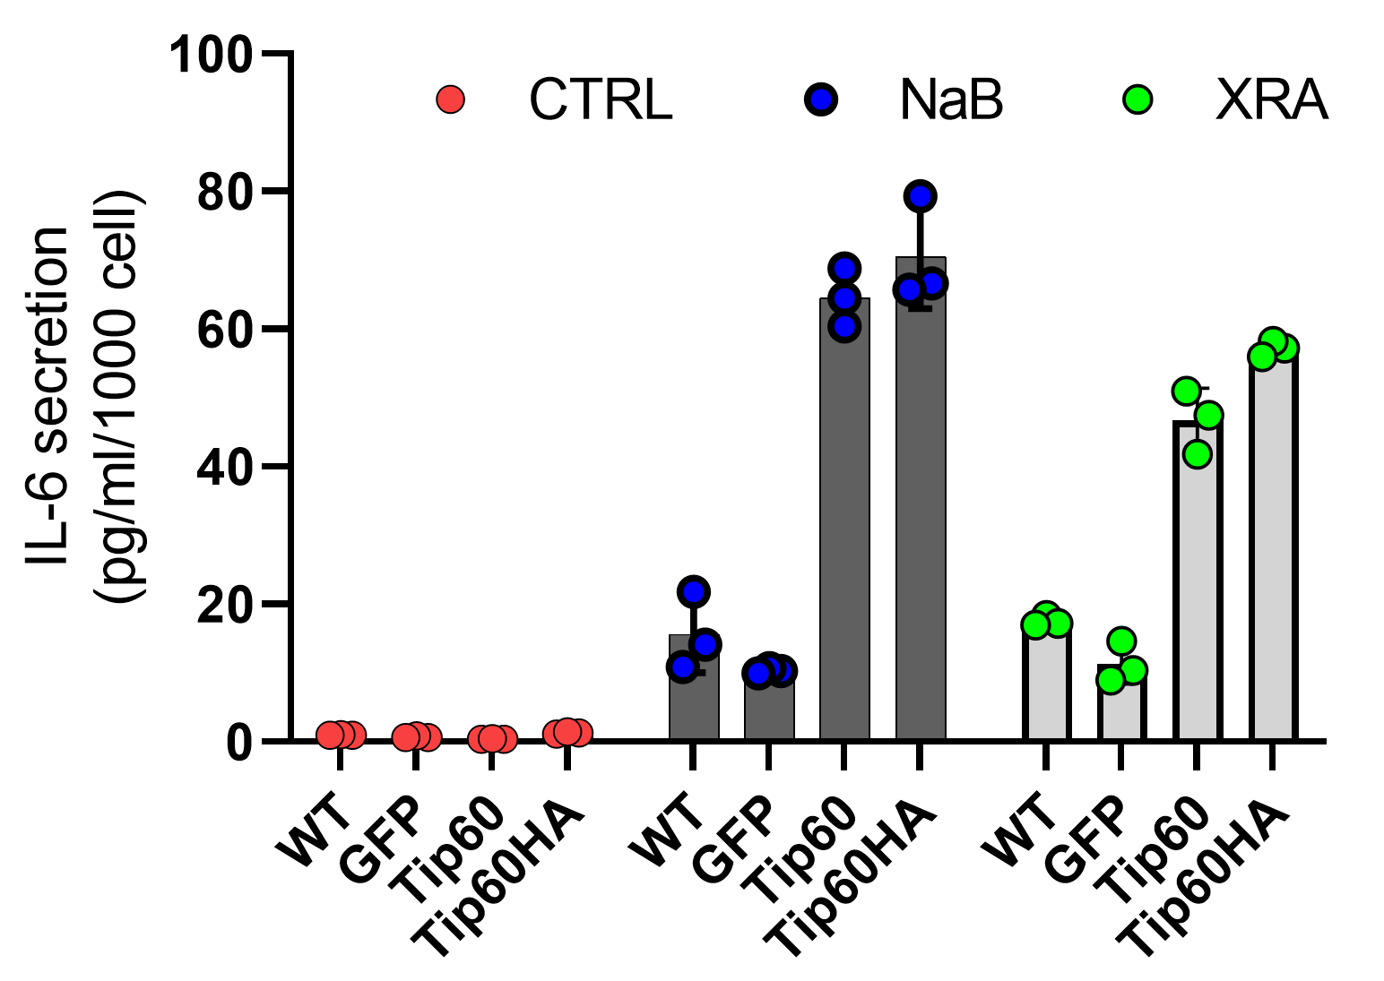
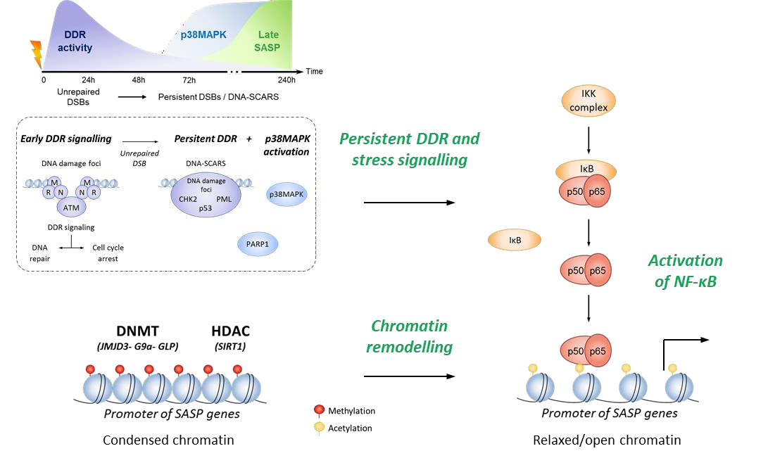
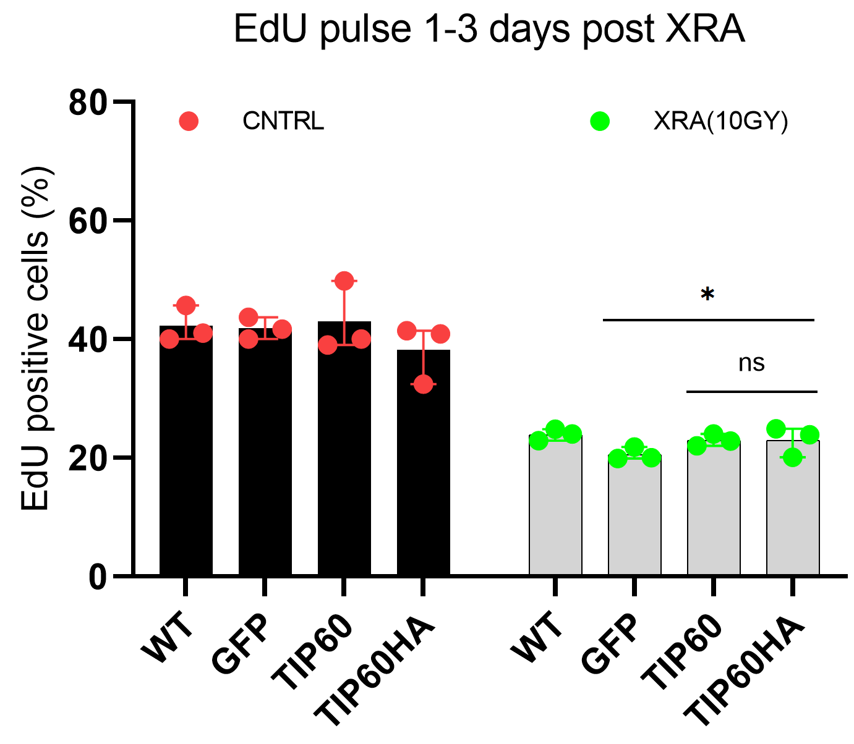
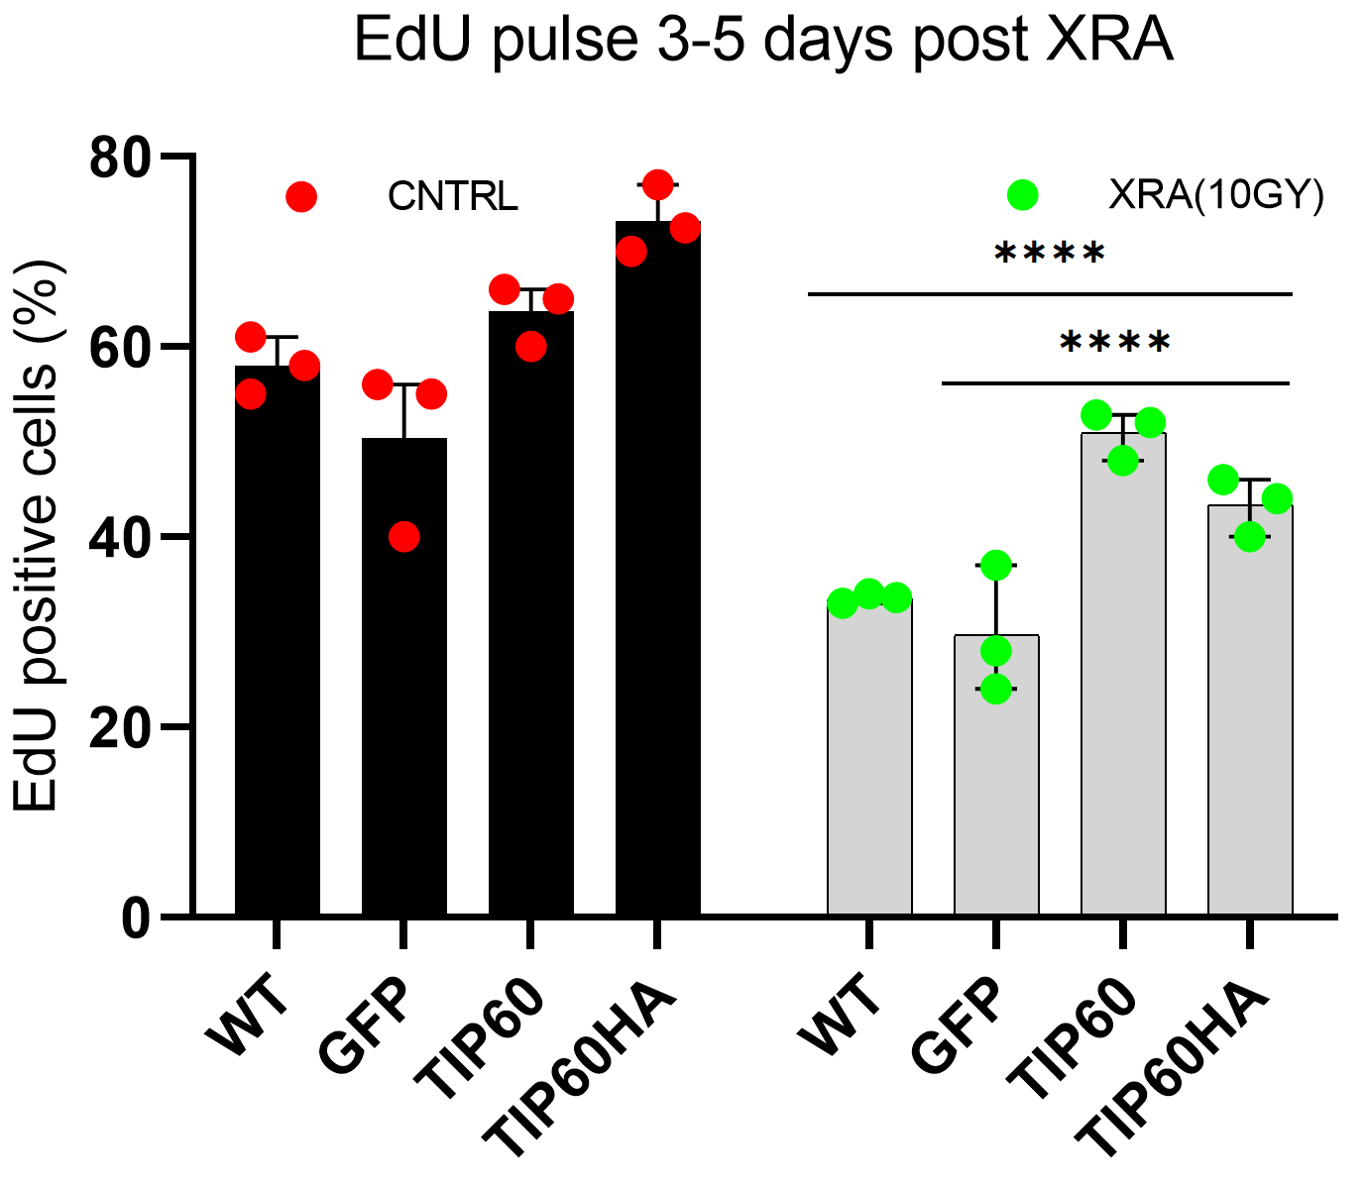
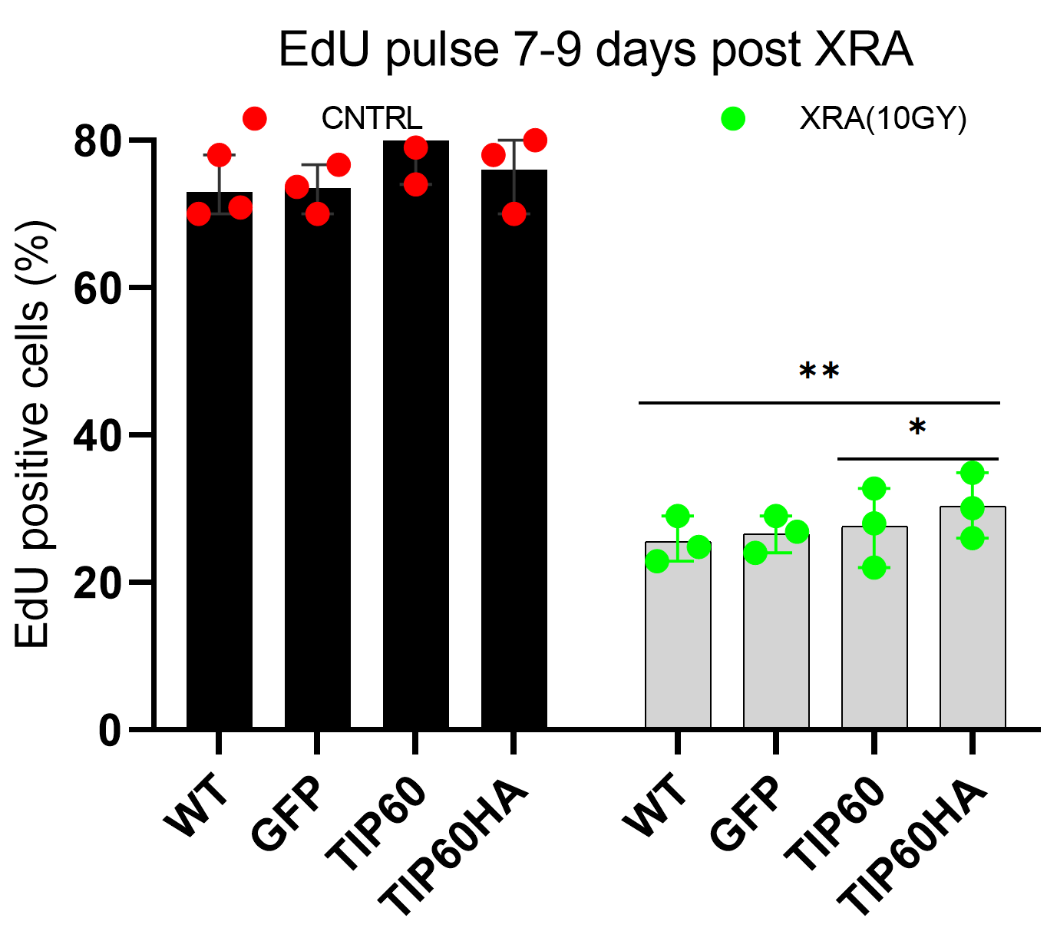
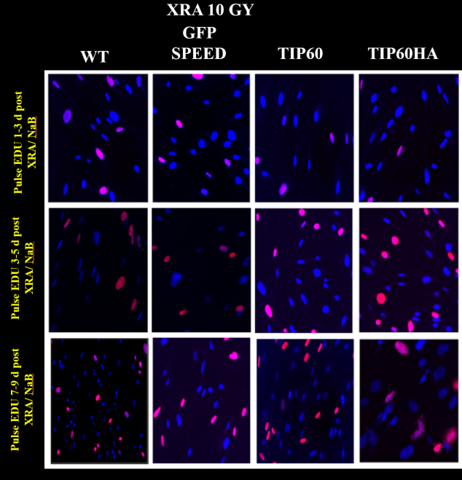
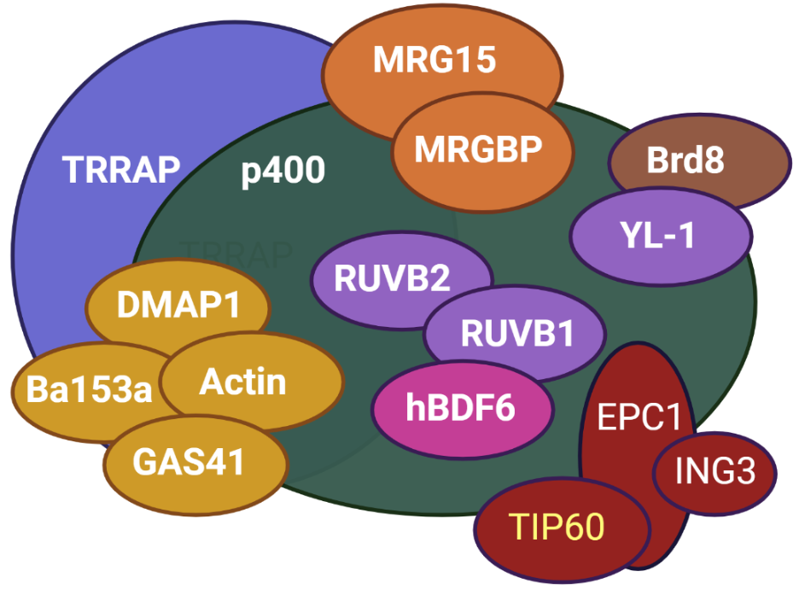
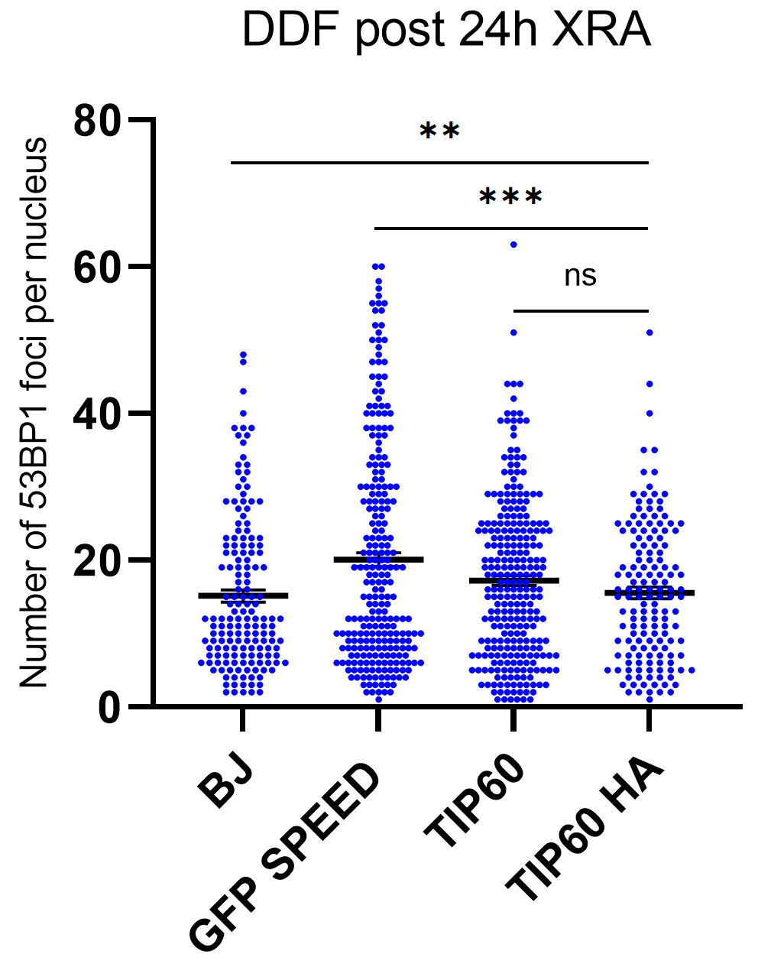
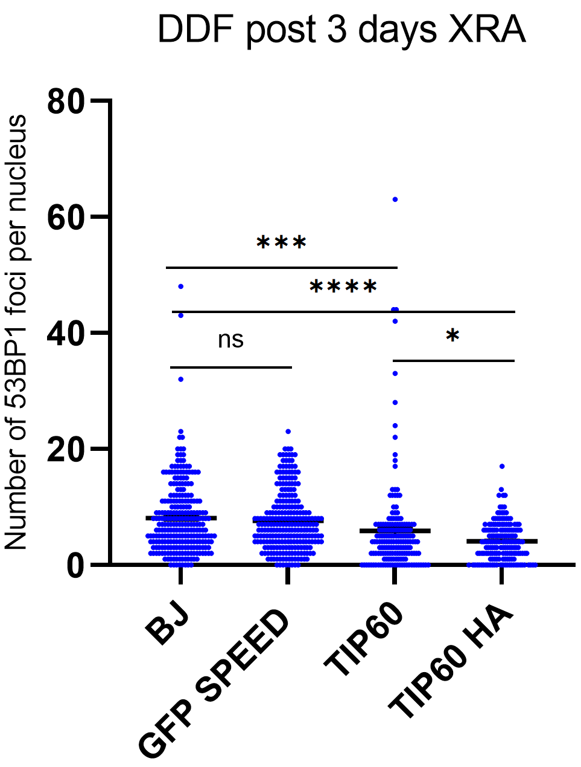
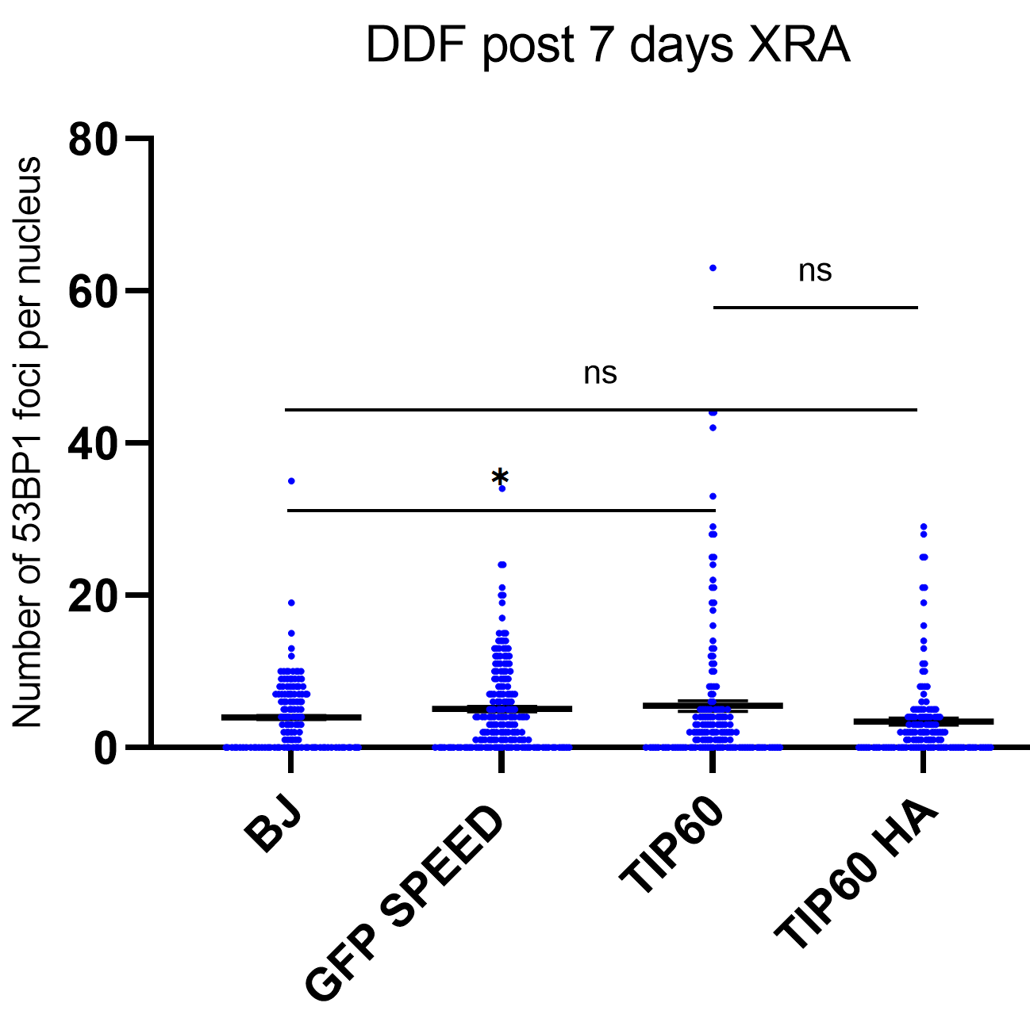
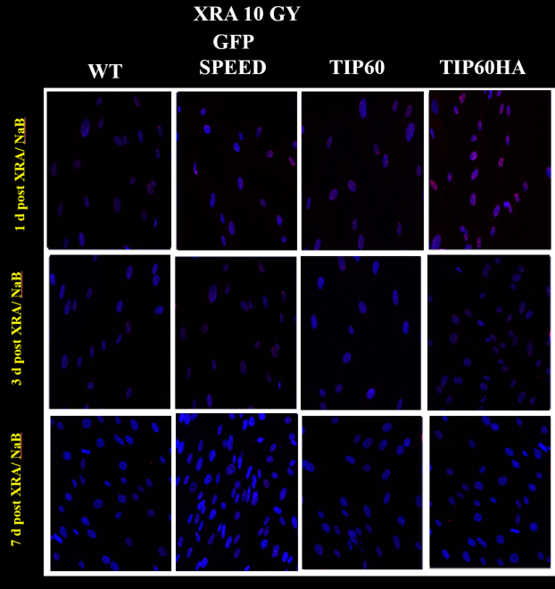
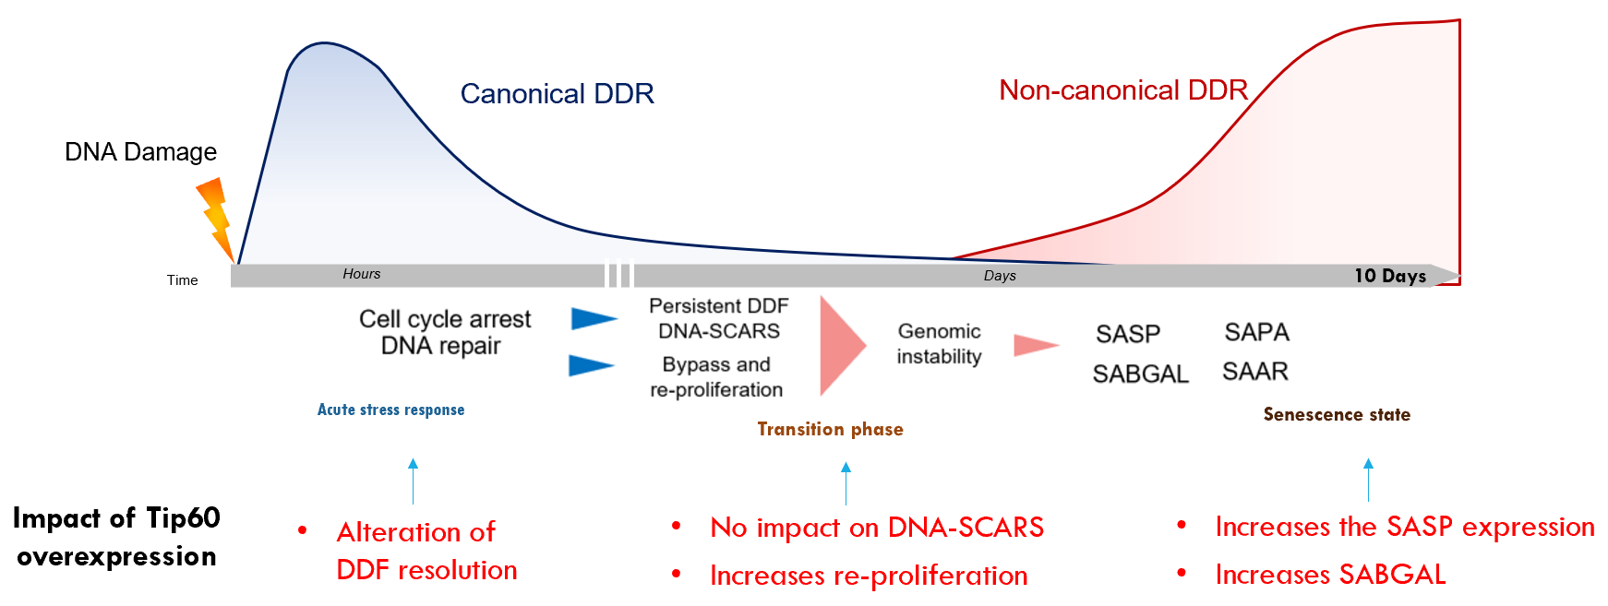
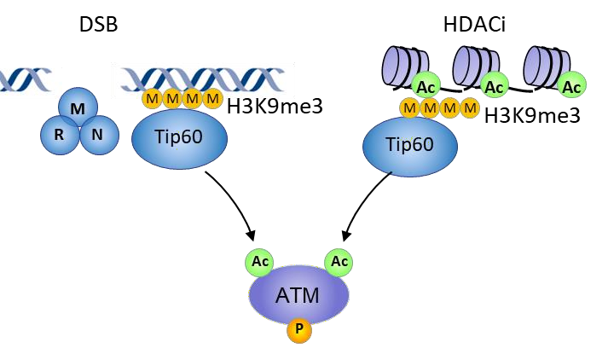
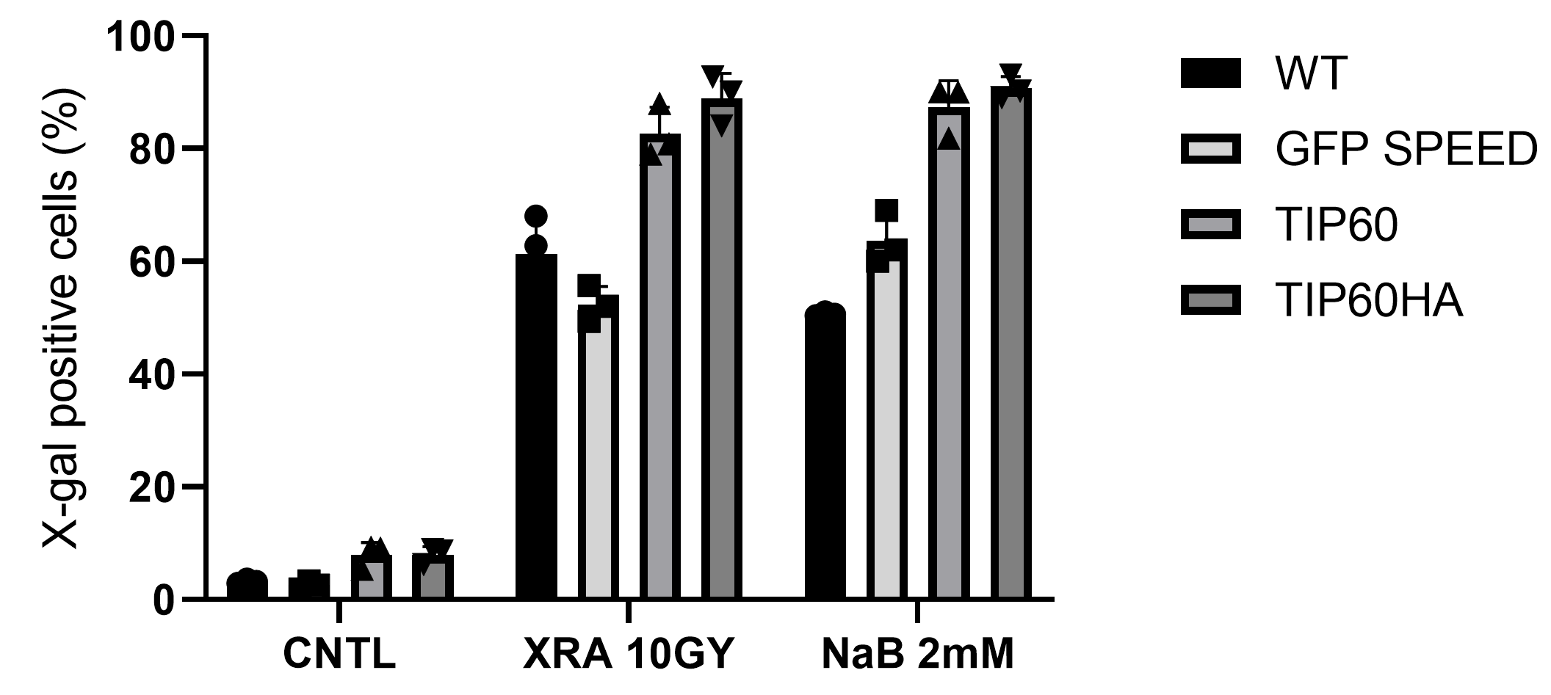
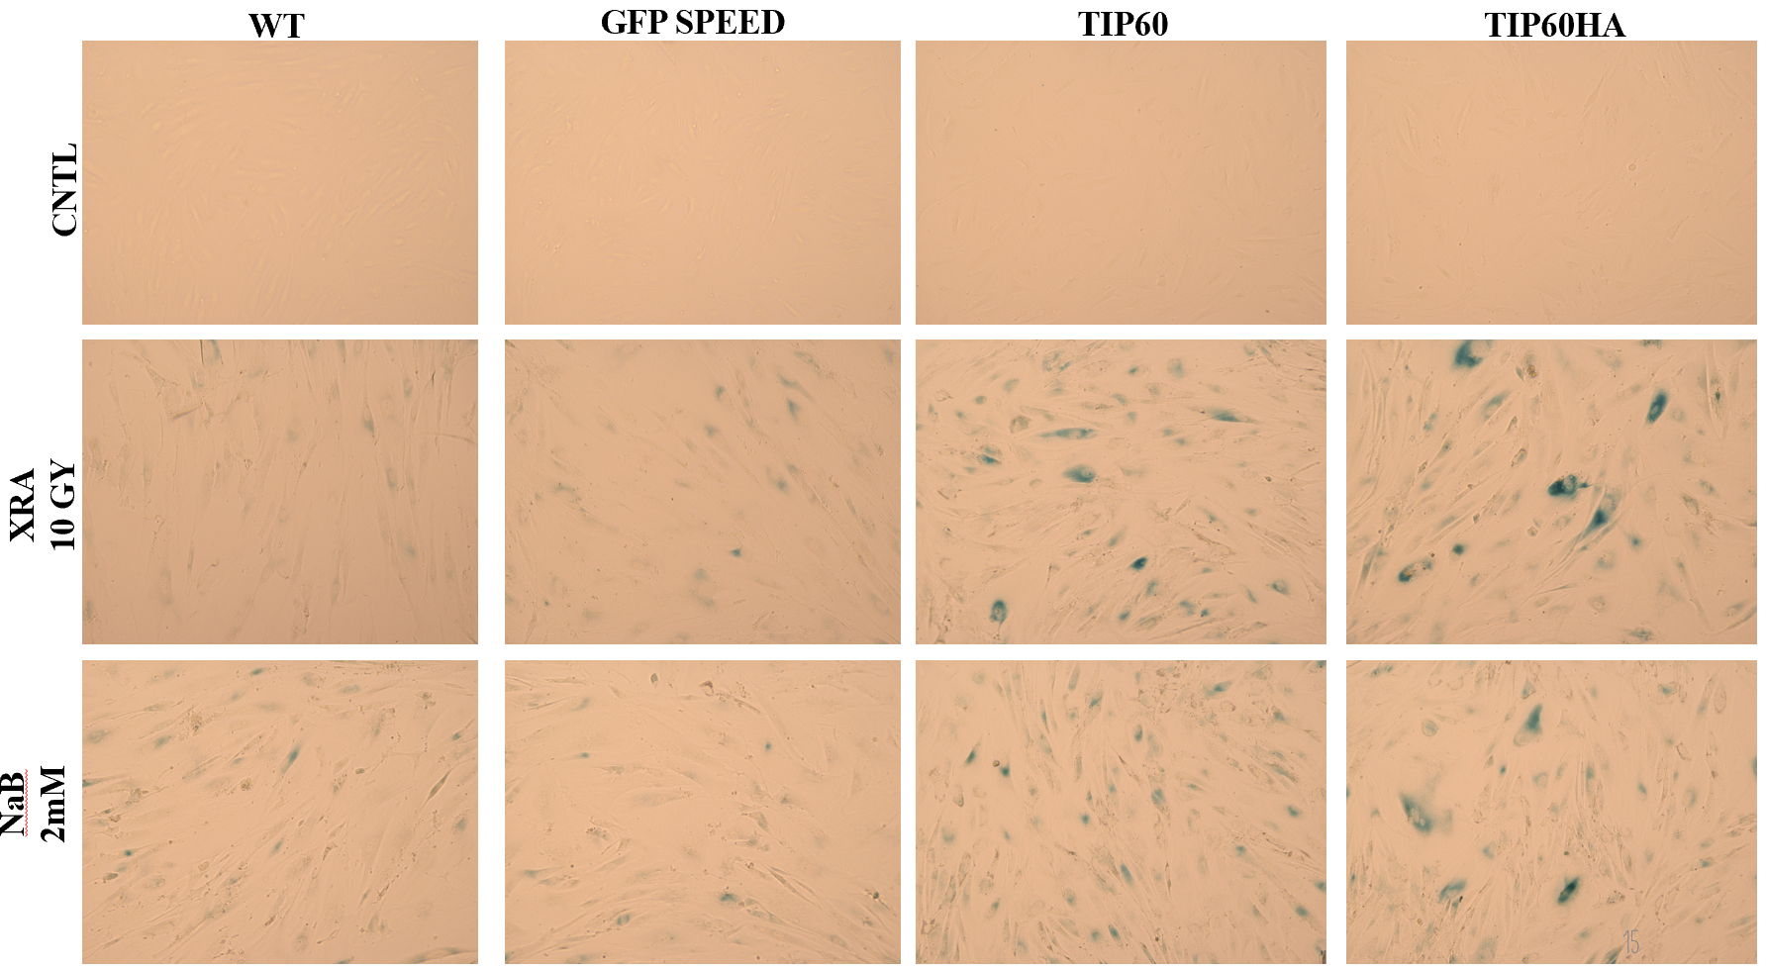
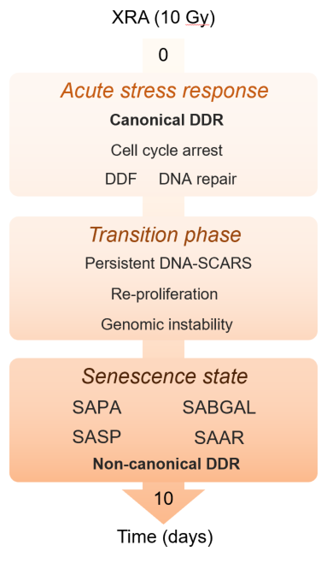
Role of the Acetyltransferase TIP60 (KAT5) for the pro-inflammatory secretory phenotype of senescent cells
Shiksha Dutta^{1,2}, Nicolas Malaquin¹, Francis Rodier^{1,3}
¹Cancer axis, CHUM Research Center and Montreal Cancer Institute, Montreal, Canada, ²Department of Medicine, University of Montreal, Montreal, Canada, ³Radiology, radio-oncology and nuclear medicine department, University of Montreal, Montreal, Canada.
Introduction & Hypothesis
Results
Results
The multifaceted roles of senescence-associated secretory phenotype
Effect of TIP60 Overexpression
Effect of TIP60 Genetic Depletion
Cellular senescence is a tumor suppressor mechanism that prevent proliferation of damaged cells. Importantly, senescent cells produce a pro-inflammatory senescence - associated secretory phenotype (SASP) (cytokines, growth factors, MMPs) with beneficial or detrimental effects depending on the context.
1. Validation of TIP60 Overexpression pre & post 10 Gy XRA
2. SASP (IL-6)
1. Validation of TIP60 Genetic Depletion
2. Effect of TIP60 Overexpression on SASP Factors, Cell Cycle Regulators, Apoptotic Markers
The expression of the SASP factors is regulated by multiple molecular pathway
Immediately after the damage, ATM and the MRN complex (MRE11-Rad51-NBS1) are activated and initiate the DDR. It is previously shown that persistent DDR signaling controls the SASP in senescent cells (Rodier et al, Nat cell Biol, 2009; Rodier et al, JCS, 2011). While DDR activity and initiation of growth arrest occurs within minutes after DNA lesions, the complete expression of SASP factors requires several days. This suggests that the DNA damage and the early canonical DDR signaling are not directly involved in the expression of SASP factors
3. Cell Proliferation at Acute Stress, Transient & Mature Senescent Phase
4. DNA Damage Foci (DDF) at Acute Stress, Transient & Mature Senescent Phase
TIP60 might contribute to the SASP
Conclusion
Level of chromatin acetylation, regulated by Lysine Acetyltransferases (KAT) activities, is crucial for transcriptional regulation. TIP60 is a co-activator of many transcription factors (i.e., NF-κB) and is an important regulator of the DDR signaling. In response to DNA damage, Tip60 is recruited on the chromatin promoting the activation of ATM (Sun et al, Nat Cell Biol, 2009; Kaidi and Jackson, Nature, 2013).
TIP60 has a major role in DNA Repair and regulates the DDR Signaling network and the secretion of SASP independent of the DNA Damage followed by the canonical DDR.
Hypothesis: Knowing TIP60 can acetylate multiple histone and non-histone proteins and play important roles in the DDR and DNA repair, p53 signaling, NF-κB activity and transcription regulation, we hypothesize that Tip60 has a vital role in SASP regulation and contributes to the establishment of senescence.
5. SABGAL Post 10 days of 10Gy XRA
Perspectives
Objective: Our aim is to gain knowledge of senescence as a dynamic phenomenon and its maturation by Tip60 by analyzing progressive DNA damage.
Future Directions:
Methodology
Progressive DNA Damage analysis with respect to genetic depletion of TIP60 (DDR, DNA repair, DDF, mitosis post XRA, SABGAL, SAAR and GI).
Effect of delayed inhibition of TIP60 ON SASP secretion and SA Phenotype
TIP60’s recruitment on the promoters of SASP factors
Analysis to probe the region of TIP60-NF-κB binding
TIP60’s mechanism of regulation of non-canonical DDR
Genetic Depletion of TIP60 by shRNA & Genetic Overexpression of TIP60 in primary fibroblasts
Induction of senescence in fibroblasts with 10Gy of XRA
Impact of TIP60 depletion and Overexpression on proliferation, DDF, GI and SA phenotype (SASP, SABGAL and SAAR)
Impact of TIP60 recruitment on the promoters of SASP factors by TIP60 chromatin-immunoprecipitation (Ch-IP) to probe regions of NF-κB binding
6. Effect of TIP60 Overexpression on Prominent SASP Factors, Cell Cycle Regulators, Apoptotic Markers
Acknowledgements

