Slide 1
Volumetric analysis of plexiform neurofibroma in pediatric patients treated with trametinib
Dorsa Kiaei,^{a,b} Jean-Claude Decarie,^{c} Sébastien Perreault,^{b,d} and Mathieu Dehaes^{a,b,c}
ª Institute of Biomedical Engineering, University of Montreal, Montréal, Canada
^{b} Research Center, CHU Sainte-Justine Hospital University Centre, Montreal, Canada
^{c} Department of Radiology, Radio-oncology and Nuclear Medicine, University of Montreal, Montreal, Canada
^{d} Department of Neurosciences, University of Montreal, Montreal, Canada

Slide 2
What is Neurofibroma (NF)?
Volumetric analysis of PN patients treated with trametinib
Dorsa Kiaei
NFs are tumors of the nerve fibers. Neurofibromatosis type 1 (NF1) is an autosomal dominant tumor predisposition syndrome affecting 1:3000 people.
Symptoms: The common sign of NF1 is areas of skin hyperpigmentation referred to as “café-au-lait” spots and freckling.
Café-au-lait
Spots
Freckling
David T miller et.al., Pediatrics, 2019

Slide 3
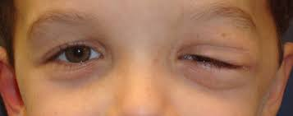
Plexiform Neurofibroma (PN)
Volumetric analysis of PN patients treated with trametinib
Dorsa Kiaei
A type of neurofibroma that grows along nerves.
30-50% of individuals with NF1 have PN.
Characteristics:
  50% occurring in the region of the head, neck, face
  Can be associated with pain and loss of function
  May have a variation in texture or darker pigmentation on top of the skin.
An orbital PN lesion
David T miller et.al., Pediatrics, 2019

Slide 4
Treatments
Volumetric analysis of PN patients treated with trametinib
Dorsa Kiaei
Surgery: It is sometime possible but limited in most patients due to location and involvement of nerves, vessels and vital structures.
MEK inhibitors: Reduces the size of PNs in many individuals with NF1 (70% of patients present a decrease of 20%)
  Selumetinib
  Binimetinib
  Trametinib: Under investigation
Imaging: Magnetic resonance imaging (MRI) scans during treatment
PNs and Treatment Evaluation

Slide 5
RECIST Criteria
Volumetric analysis of PN patients treated with trametinib
Dorsa Kiaei
The response of solid tumors is currently assessed using the RECIST
It was created in 2000 by the European Organization for Research and Treatment of Cancer (EORTC) to increase the accessibility of evaluation and decrease inflated response rates
It is suboptimal for tumors with complex and irregular shapes including lesions developing along branches of peripheral nerves
It is based on 1D and 2D measurements of the tumor.
Limitations
Therasse et al., NCI, 2000

Slide 6
Method
Volumetric analysis of PN patients treated with trametinib
Dorsa Kiaei
This ongoing multicenter phase II trial includes patients with pediatric low-grade glioma and PN.
Patients received daily oral trametinib (MEK inhibitor) for eighteen 28-day cycles.
Patients underwent MRI scans at intervals of approximately 3 months.
The volumes of PN were quantified using a practical tool that used a semi-automatic segmentation technique based on mean MRI image intensity thresholding and compared with standard assessment (RECIST).

Slide 7
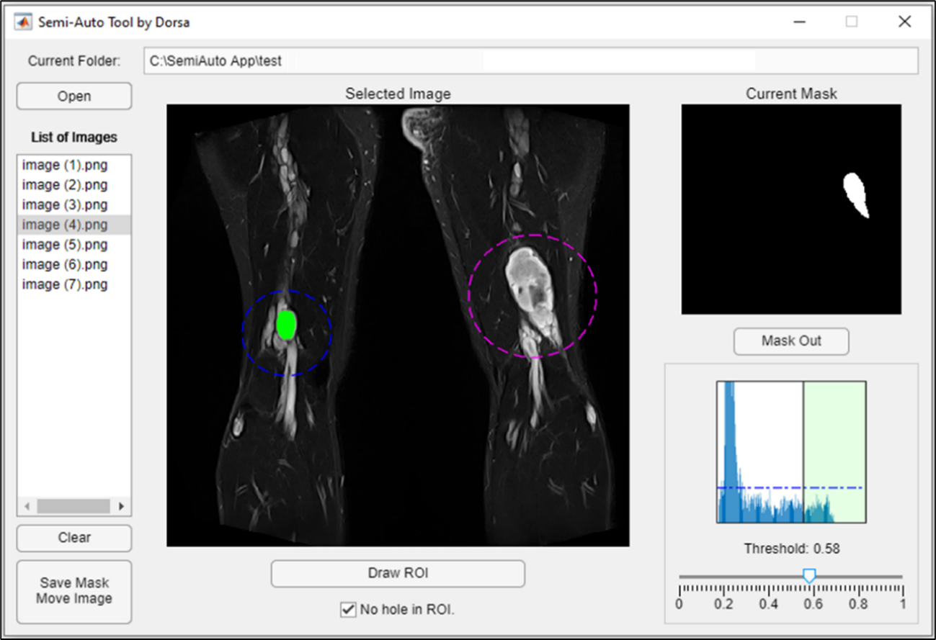
Implemented Program
Volumetric analysis of PN patients treated with trametinib
Dorsa Kiaei

Slide 8
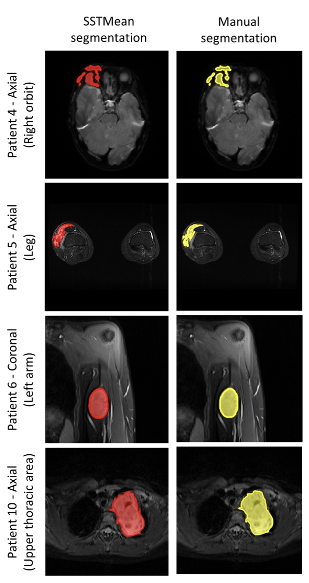
Examples of Tumor Segmentation
Volumetric analysis of PN patients treated with trametinib
Dorsa Kiaei

Slide 9
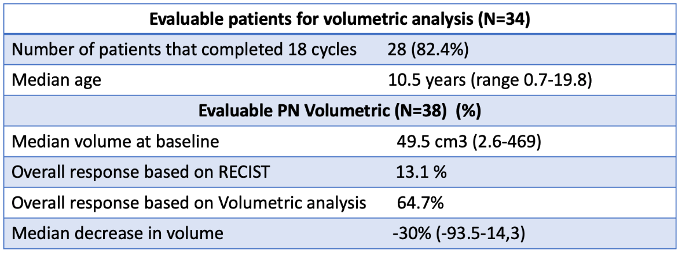
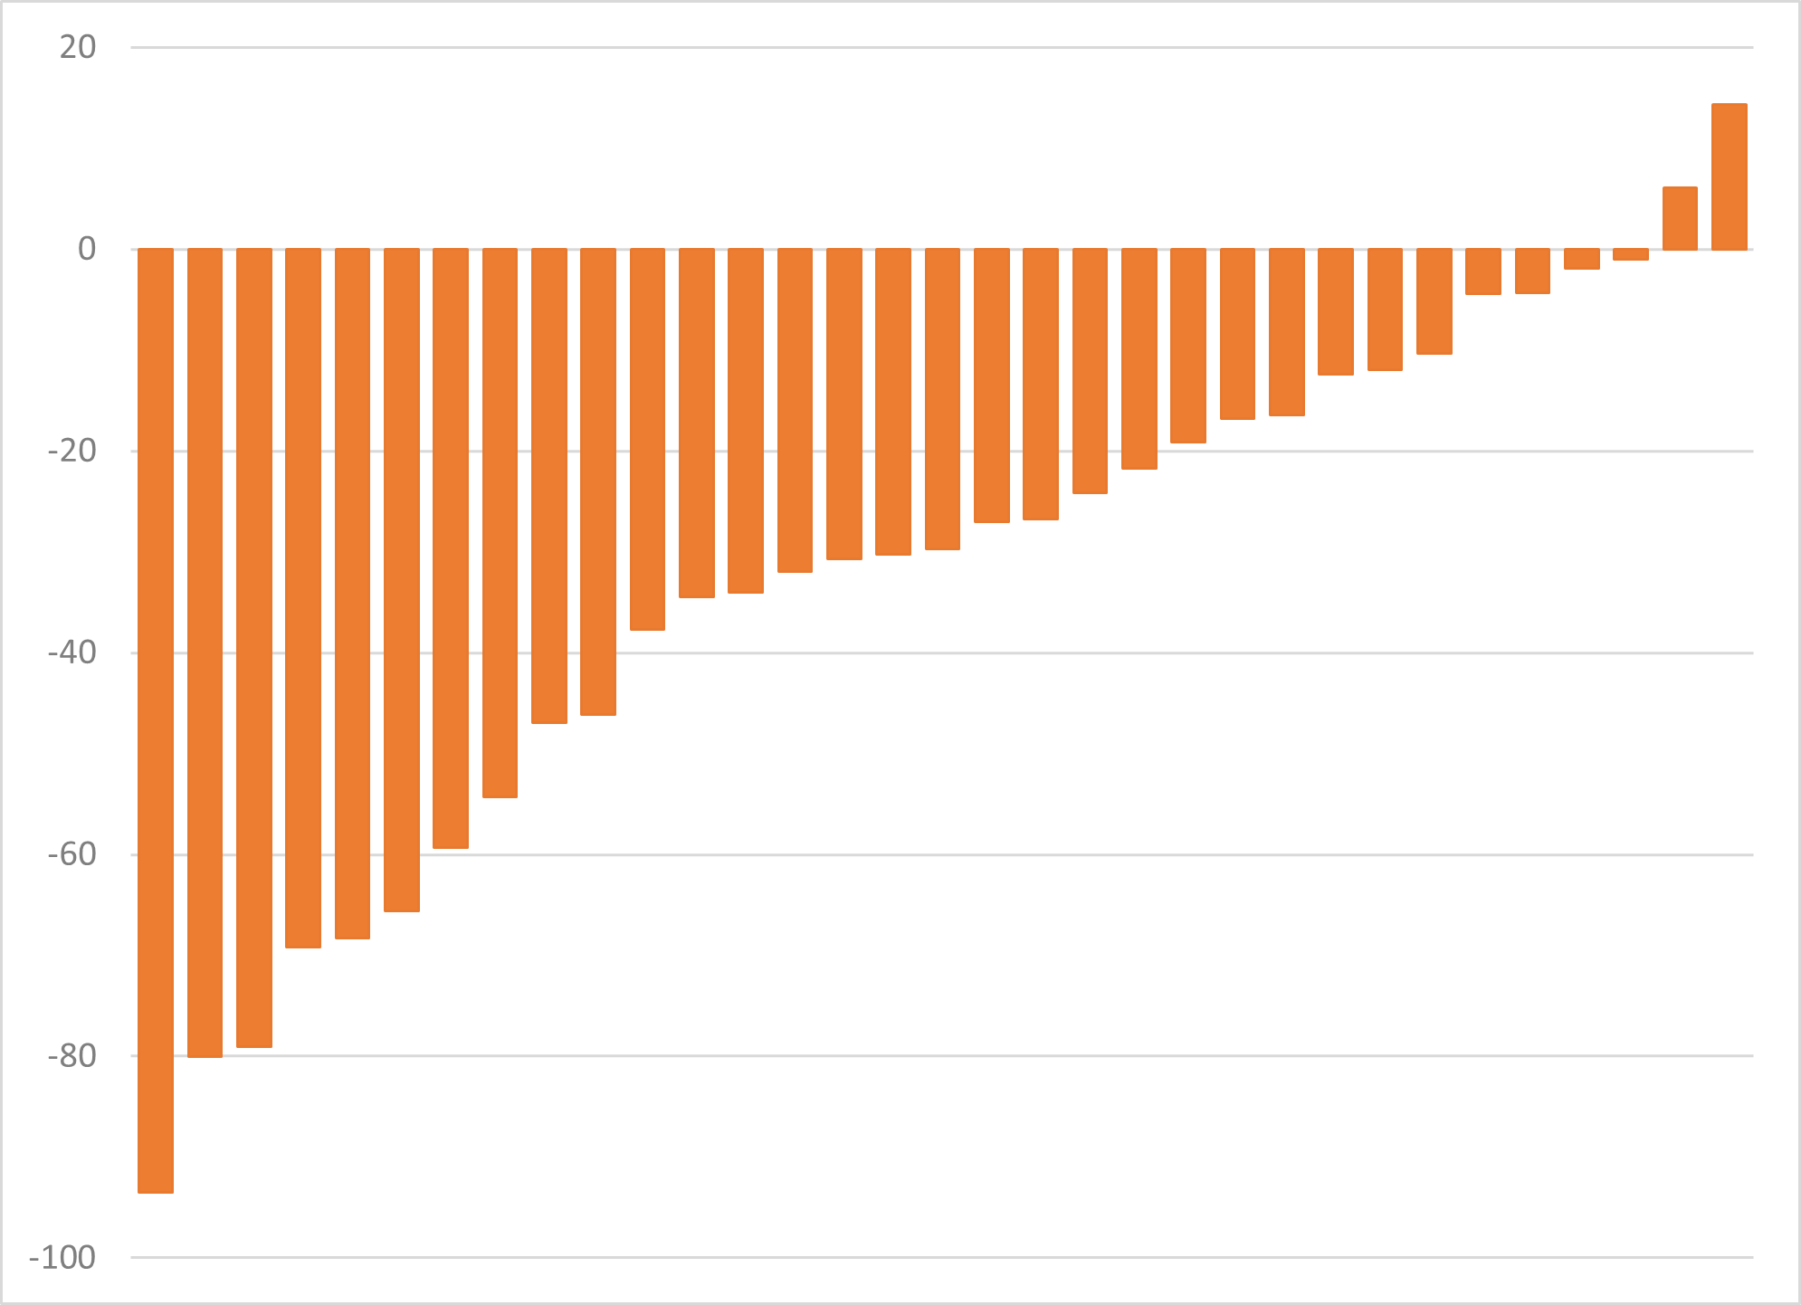
Result
Volumetric analysis of PN patients treated with trametinib
Dorsa Kiaei
Changes in tumor volume (%)
Patients
Data cut-off January 1, 2022

Slide 10
Conclusion
Volumetric analysis of PN patients treated with trametinib
Dorsa Kiaei
We reported outcome and volumetric quantification of patients with PN treated with trametinib within a large clinical trial.
Volumetric analysis is useful in tracking the volume changes during the treatment cycle.
Volumetric analysis allows to detect the response rate in tumor volumes during treatment cycle, but this is not possible while using RECIST measurement.
Based on the current results, trametinib demonstrates efficacy for treatment of plexiform neurofibroma.

